Slide 1


NEHRU INSTITUTE OF ENGINEERING AND TECHNOLOGY
Thirumalayampalayam, Coimbatore - 641 105
(Approved by AICTE, New Delhi and Affiliated to Anna University, Chennai)
Accredited by NAAC with A+, Recognized by UGC with Section 2(f) and 12(B)
NBA Accredited Programmes : AERO, CSE
DEPARTMENT OF COMPUTER SCIENCE AND ENGINEERING
Automatic Road Quality Detector
Batch Number : Internal Guide :
Batch Member & Reg. No.:

Slide 2

Abstract
Driving on smooth roads is something everyone enjoys and certainly provides for a much safer environment. Rough and jagged roads can be hazardous to those who drive on them, leading to the possibility of more accidents, and most significantly, more deaths. The condition of roadways can vary greatly within both urban and rural areas, and therefore, devices that can aid in quickly identifying hazardous roadways can be extremely valuable to engineers and government striving to increase the safety and quality of their metropolitan area. In this project, we propose an automatic road quality detector for road quality monitoring and logging. One advantage of this system is that it is designed for any type of vehicle, so it can be embedded with any vehicle on road. All the vehicles will be connected to a common cloud platform for uploading all the road information with the corresponding locations.

Slide 3
Introduction
This IoT device consists of a NODE MCU, Inertial Measurement Unit , a GPS module, and an Sensor modules. When mounted to the user's car or truck, the device can detect spikes in the acceleration of the vehicle. While sensing, the device will store the locations of hazardous road conditions in its EEPROM memory, which it can later read from and upload to a database. It will attempt to connect to its Wi-Fi network where a computer will be running a Python script that accepts binary data from the module. The binary data consists of the device's identifier and all of the sensor readings the device has measured in the past trips that have not been uploaded yet. The running of the Python script removes the operational overhead from the module, allowing for the fastest possible relaying of data to the database. While this prototype IoT device is simple, its capability to successfully and automatically identify hazardous road conditions could enable it to reduce the number of road-related crashes and deaths. Giving city maintenance engineers, and construction companies access to the locations of hazardous roads has the capacity to save thousands of lives all around the world
28-04-2023
Computer Science and Engineering, Nehru Institute of Engineering and Technology
3

Slide 4
Objective(s)
The goal of this project is to develop a prototype capable of aiding in the solving of one of the major problems in urban, suburban, and rural areas.
To design and implement a system to monitor road quality using data from all vehicles.
To obtain improved and uniform standard of road construction.
To minimizing the cost of quality control.

Slide 5
Existing System and Limitations
Existing System
Direct observation method it means the staff directly relies on their own quality control experience to detect the actual construction quality of roads.
Recognizing the road quality using high resolution satellite imagery.

Slide 6
Existing System and Limitations
Limitations
In road quality detection using satellite image was not efficient and accurate and also it depends on the climate, quality and quantity of data available .
Direct observation method is not cost efficient. It cost 2 to 5 percent of total construction cost every year.
In the existing system the accuracy is less and these solutions come with a high cost, closed source code, excessive human analyst.

Slide 7
Proposed System and Advantages
Proposed System
This system is designed for automatic road quality monitoring and logging. This system can be embedded in any vehicle on road.
we use different kinds of smart sensors for detecting anomalies on the road, such as an accelerometer sensor for detecting bumps and gutters on the roads by calculating the linear acceleration of the vehicle, if any anomaly is detected then the location of the vehicle is noted using GPS module embedded with the system. This data is uploaded to a cloud for creating a map based on which maintenance can be done.
Advantages
In proposed system accuracy and efficiency is high and also comes with low cost.
Time and Cost Management.

Slide 8
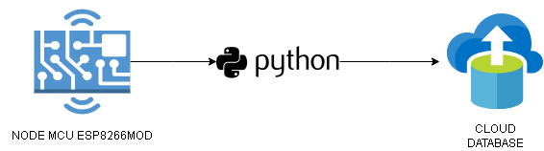
System Architecture
28-04-2023
Computer Science and Engineering, Nehru Institute of Engineering and Technology
8

Slide 9
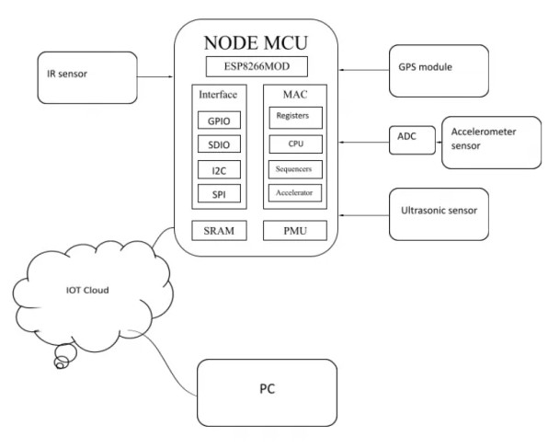
Block Diagram
28-04-2023
Computer Science and Engineering, Nehru Institute of Engineering and Technology
9
28-04-2023
Computer Science and Engineering, Nehru Institute of Engineering and Technology
9

Slide 10
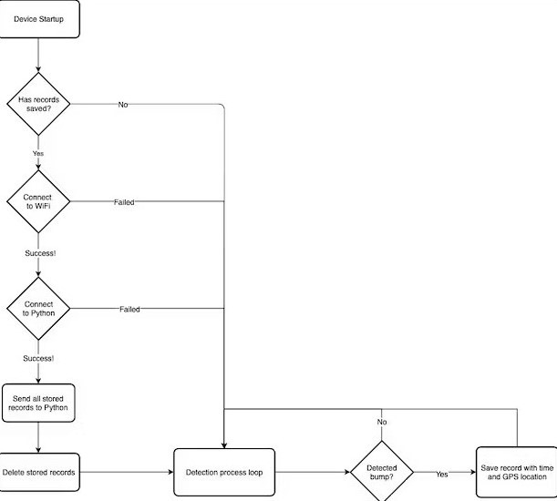
Data Flow Diagram
IoT Device Flowchart
28-04-2023
Computer Science and Engineering, Nehru Institute of Engineering and Technology
10
28-04-2023
Computer Science and Engineering, Nehru Institute of Engineering and Technology
10

Slide 11
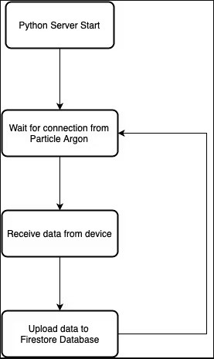
Data Flow Diagram
Python Server Flowchart
28-04-2023
28-04-2023
Computer Science and Engineering, Nehru Institute of Engineering and Technology
Computer Science and Engineering, Nehru Institute of Engineering and Technology
11
11
28-04-2023
Computer Science and Engineering, Nehru Institute of Engineering and Technology
11

Slide 12
System Requirements
Hardware Requirements:
Processor : Intel i3 or More
Ram : 4GB or More
Hard Disk : 128GB or More
Network : Wireless Network
Hardware Components:
NodeMCU : ESP8266MOD
Sensor Modules : IMU, GPS, IR and Ultrasonic
Power Supply : 9v Battery or 3.7v LiPo Battery
Connection : Connecting Jumper Wires and JST Wire
Software Requirements:
Operating System : Windows 7/8/9/10/11
SDK : Python 3.9.5
IDE : Arduino 2.1 and Firebase
28-04-2023
28-04-2023
28-04-2023
Computer Science and Engineering, Nehru Institute of Engineering and Technology
Computer Science and Engineering, Nehru Institute of Engineering and Technology
Computer Science and Engineering, Nehru Institute of Engineering and Technology
12
12
12
28-04-2023
Computer Science and Engineering, Nehru Institute of Engineering and Technology
12

Slide 13
List of Modules
Assembly
Programming
Cloud Database

Slide 14
Module Description
Assembly
The physical components that a system requires to function. It encompasses everything with a circuit board that operates within a system. It including the motherboard, sensor modules, power supply, and so on.
Programming
The Arduino programming language has compiled on the Arduino IDE. It can be downloaded from https://www.arduino.cc/. This programming language is based on a simple hardware programming language called Processing, which is very similar to C language

Slide 15
Module Description
Cloud Database
After all devices are connected, we can move to compile code for ESP8266 to connect it to the Internet. When it is connected successfully, ESP8266 acts as a client and starts communicating with server. It needs to go through some steps before the server stores data. First, the data must be available. It means that the sensor should be able to transfer info from real world into data. We are using firebase is a set of backend cloud computing services and application to store and retrieve data.
28-04-2023
Computer Science and Engineering, Nehru Institute of Engineering and Technology
15

Slide 16
Module Implementation
Once powered on, the device will detect high amplitude vibrations in whatever surface it is attached to and save them to its EEPROM chip. The device reads the Z axis acceleration value which aligns with an up/down vector. As the device operates, it keeps track of a rolling mean of the previous 1s of data and can compare its current Z-axis acceleration value with that moving average. When the amplitude of the difference between the current value and the current moving average is beyond a certain threshold, the detection code is triggered. Based on the following graph, the rolling mean of acceleration data allows the device to smooth out the noisy accelerometer data.

Slide 17
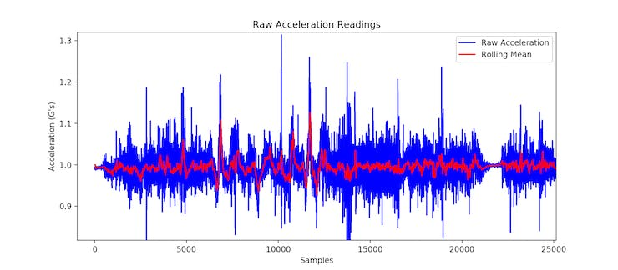
Module Implementation
Acceleration Data Readings
28-04-2023
Computer Science and Engineering, Nehru Institute of Engineering and Technology
17

Slide 18
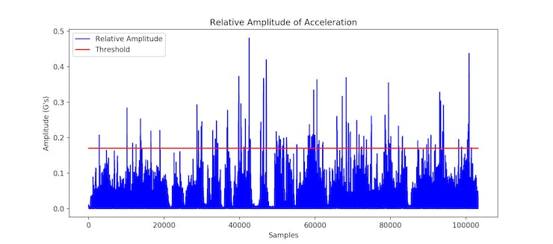
Module Implementation
The following graph shows the absolute value of the difference between the measured accelerometer value and the current value of the rolling mean. Whenever a sample rises above the threshold line of 0.17G's, the detector has detected a bump in the road.
28-04-2023
Computer Science and Engineering, Nehru Institute of Engineering and Technology
18

Slide 19
Module Implementation
While this threshold of 0.17G's may seem arbitrary, it is, in fact, not. In my initial test runs of this device, I had the device directly connected to a laptop which was saving the raw data the device measured. While driving, I mounted a button on the device that would mark what I believed to be a significant bump in the road. After a test drive of collecting data, I could later review the data and graph it based on Latitude and Longitude, drawing markers at where it detected bumps in the road. I could then modify the threshold to produce the fewest false-positives and the most true-positives. Below figure shows like quite a few possibly hazardous locations, and that would be exactly correct. Based on these results, this device can successfully identify the locations of hazardous, uneven, and significantly rough roads, increasing public awareness of road conditions and enabling the faster repair of these dangerous roads. After being powered on again, the device will attempt to communicate over Wi-Fi with the Python script to upload its readings to the Firestore Database. The ease of access the Firestore database provides would enable a massive fleet of these devices to report the locations of hazardous roads all around the world automatically.
28-04-2023
Computer Science and Engineering, Nehru Institute of Engineering and Technology
19

Slide 20
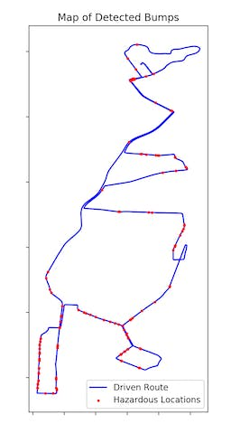
Sample Output
28-04-2023
Computer Science and Engineering, Nehru Institute of Engineering and Technology
20
28-04-2023
Computer Science and Engineering, Nehru Institute of Engineering and Technology
20

Slide 21
Conclusion
This paper investigates on the feasibility of an road surface quality control in terms of surface anomalies detection by means of sensor devices. The algorithm developed to detect road bumps and potholes was based on the analysis of the vertical acceleration impulse. The temporal derivative of the acceleration absolute amplitude in one second that was calculated as the difference between the maximum and the minimum value in the defined unit of time. The vertical acceleration impulse corresponds to a high-energy event, that is labelled as an “Hazardous Location” on the road surface. In order to better understand how the acceleration signal monitored by means of the device located inside the vehicle can be used to classify the road damage severity. Results showed that there was a linear relationship between the acceleration impulse and the potholes.
Future work will also address to the possibility of giving an useful tools to road maintenance operators for the monitoring of road quality and for a more adequate allocation of resources.

Slide 22
References
Astarita, V., Caruso, M.V., Danieli, G., Festa, D.C., Giofrè, V.P., Iuele, T., & Vaiana, R. (2012). A mobile application for road surface quality control: UNIquALroad. Procedia - Social and Behavioral Science ,54, 1135-1144, DOI: 10.1016/j.sbspro.2012.09.828.
Bhoraskar, R., Vankadhara, N., Raman, B., & Kulkarni, P. (2012). Wolverine: Traffic and road condition estimation using smartphone sensors.
PRISM: Platform for Remote Sensing using Smartphones. MobiSys’10, June 15–18, San Francisco, California, USA.
Environmental Impacts and Fuel Efficiency of Road Pavements, Industry ReportMarch 2004.
Mohan, P., Padmanabhan, V. N., & Ramjee, R. (2008). Nericell: Rich monitoring of road and traffic conditions using mobile smartphone. ACM SenSys 2008, Raleigh, North Carolina, USA.

Slide 23


